Slide 1
Best Practices for Protecting Data

Slide 2
Section Overview
Data Inventory
Privacy Officer
De-identified data
Passwords
Email
Workstation and File Security
Mobile Computing Devices
Technical Procedures
Data Access and Permissions
Verbal Communication
Paper Copies
Data Destruction

Slide 3
Data Inventory
Address key questions about your data with a data inventory:
What systems do we have?
What data do they store?
What reports and exports are available?
Who are the users?

Slide 4
Data Inventory Example
System | Types of Data | Reporting Features | Users
Student Information System | Demographics, Schedules, Grades, Attendance, etc. | Ad-hoc, Pre-defined, User-defined, Exports | Administrators, Teachers, Secretaries
http://nysdsp.org/best-practices-for-protecting-data
Notes:
Notes
An excel template is available on the website.
The template includes tabs for both Data and Assessments.
Districts should also inventory assessments, who uses them, and why.
Focus on data driven instruction is a key reason district’s store and utilize large amounts of data.
Districts should determine if any of the assessments are redundant , or not helpful in informing curriculum, instruction, and placement. They may also determine that certain assessments need to be added or deleted.
It is important to know who the users are and what kinds of access they have to data , reports and export when thinking about Data Access Control (Need to Know….)
Other options include assigning a security level to the types of data

Slide 5
Determine who is responsible for the following data and privacy issues:
Privacy Officer
Leading a district data security team
Educating staff on regulations, best practices and policy
Management and delivery of data
Maintaining information on agreements and contracts
Maintaining logs of users with access to PII
Documenting data collection processes
Acting as a contact for the public on privacy questions and concerns
Notes:
Notes
Most districts do not have a dedicated privacy officer at this time, but should be thinking about the areas of responsibility discussed here.
Stay current on updates and guidance to come from the NYS CPO.

Slide 6
De-identify Data
De-identify detail data used in analysis, projects and presentations:
Name | Grade | SPED | Math 3 Level | ELA 3 Level
Student 1 | 4 | No | Level 3 | Level 4
Student 2 | 4 | No | Level 3 | Level 3
Student 3 | 4 | No | Level 2 | Level 1
Student 4 | 4 | Yes | Level 3 | Level 2
Student 5 | 4 | No | Level 4 | Level 4
Student 6 | 4 | No | Level 3 | Level 3
De-identified data - Data regarding students that uses random identifiers.
Notes:
Notes
The slide shows a simple example. More complicated methods may be needed depending on the data elements involved and the level of protection desired.
See (PTAC Document) Data De-Identification Terms: An Overview of Basic Terms for details on data de-identification terms and strategies including Masking, Perturbation, Redaction and Suppression

Slide 7
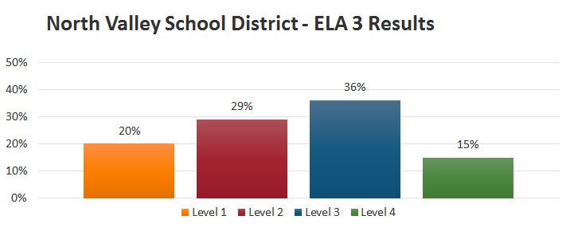
De-identify Data
Use aggregated data where possible:
Aggregated Data - Anonymized data that can not be used to identify a particular student. Reported at the school or district level.
Notes:
Notes
Use charts and graphs of summarized data. Don’t retain, transfer or print copies of underlying detail data where possible.

Slide 8
Indirect Identification
Be mindful of indirect identification issues:
Subgroup | Percent Proficient
American Indian | 83.4%
Asian | 87.7%
Black | 91.7%
Hispanic | 81.0%
Two or More Races | 0.00 %
White | 79.2%
Notes:
Notes
The slide shows a simple example - If there were only one or very few students’ of mixed race, they can be identified.
State reports redact information on groups of 5 students or less.

Slide 9
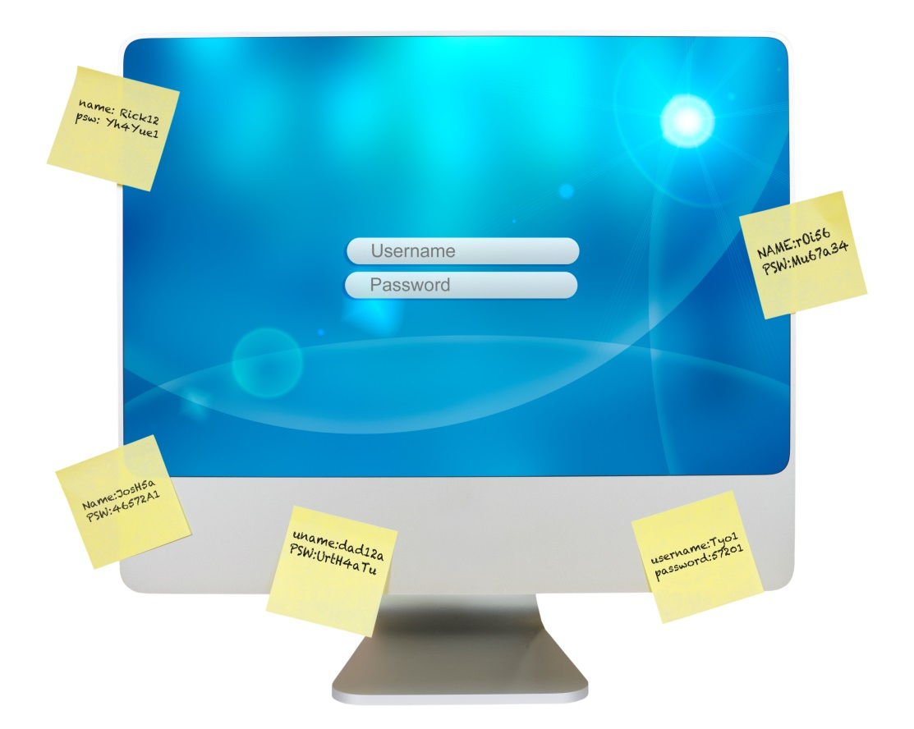
Passwords
Employ password protection strategies:
Strengthen passwords
Make every new password a unique password
Change passwords regularly
Never write down or share passwords
Disable the “Remember Password” function in browsers
Change passwords immediately if compromised
Use a secure password management method

Slide 10
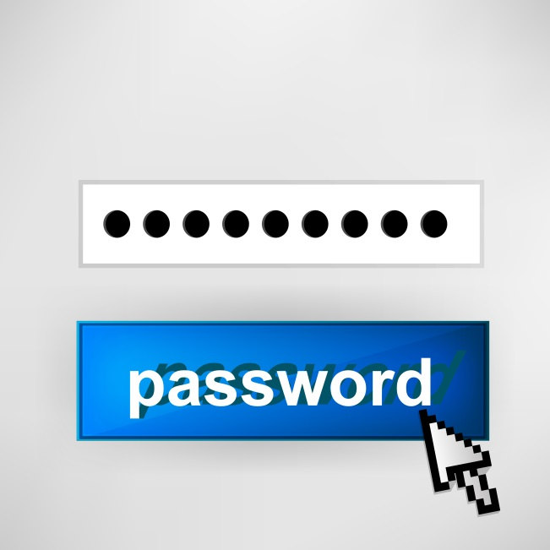
Password Strength
Strong Passwords…
Are 8 or more characters long and contain a mix of upper and lowercase letters, numbers, and symbols…
Ham&3gg$ is stronger that hamandeggs
…and are easy to remember
Hwd2tmnc2L! can be remembered from the passphrase
He who dares to teach must never cease to learn!

Slide 11
Passwords
Weak Passwords…
Are the same as your login or contain family names
Jsmith or raymond
Contain common words
Football
Contain easily accessible information about you
Mathteacher Contain only numbers or letters
123456 or abcdef

Slide 12
Email
Consider security and privacy issues related to everyday use of email
Senders
No longer control information once it is sent
Could choose the wrong address
Receivers
May forward it to others, or print a copy
Sometimes leave workstations unsecured or have weak passwords
Notes:
Notes
It is very common to choose the wrong address or accidently “Reply To All”. Most people have seen examples, such as email mistakenly sent to listervs.
Best to avoid personal and sensitive data in email or attachments
Email can be FOILed

Slide 13
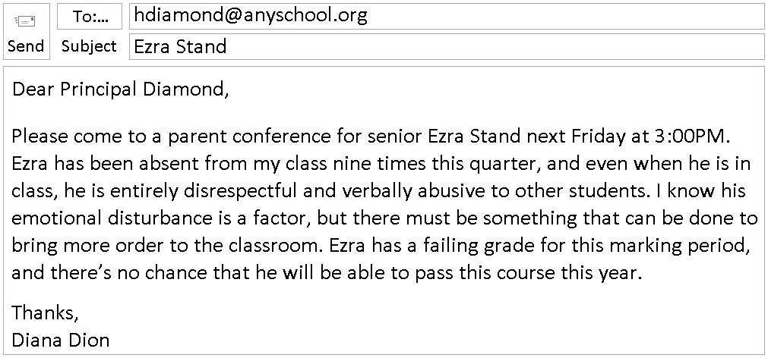
Email
Do not include personal or sensitive information:
Notes:
Notes
In this example, the sender could request a meeting with the principal without providing detail.
School staff should also be mindful of personal and sensitive information in emails to RIC support staff and vendors.

Slide 14
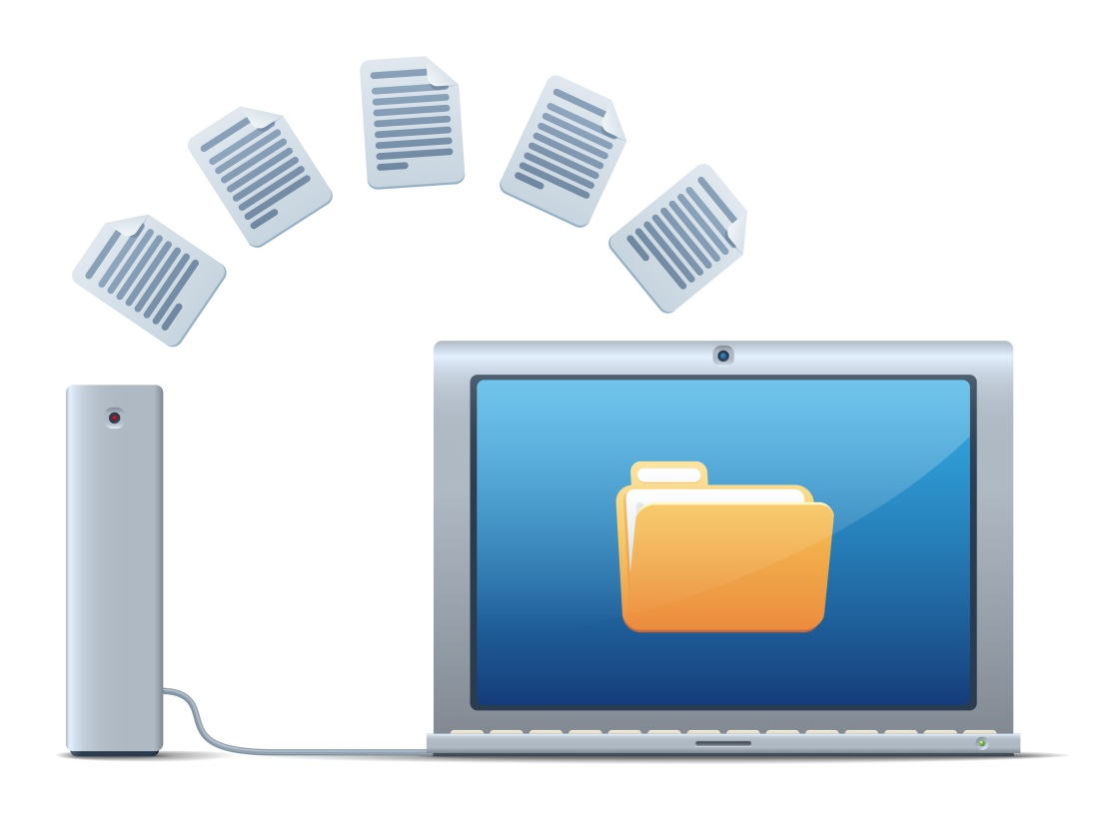
Workstation and File Security
Secure workstations and files:
Lock your workstation when not in use
Download and store documents with sensitive information on secure network drives - not workstations!
Use only encrypted USB flash drives (if used at all)
Notes:
Notes
Many issues here are dependent on organizational specifics – workstation policy, permission, data transfer methods, etc.

Slide 15
Workstation and File Security
Secure workstations and files:
Use secure methods such as SFTP or remote desktop applications to transfer sensitive data– not email!
Follow district specific policies and procedures on file storage, data transfer and cloud applications.
Store physical media in a secure area
Notes:
Notes
Many issues here are dependent on organizational specifics – workstation policy, permission, data transfer methods, etc.

Slide 16
Implement MCD policies, and inventory data and equipment:
Mobile Computing Devices - MCDs
Develop policy that addresses the protection of data on MCDs
Develop breach notification policy and procedures
(including actions for employees to take in the event of a breach)
Inventory personal and sensitive data stored on MCD’s and update on an ongoing basis
Notes:
Notes
Reference : http://www.osc.state.ny.us/localgov/audits/swr/2012/securityppsi/global.pdf
Suggestions on locking methods include Windows-L and CTR-ALT-DELETE. Methods may depend on district policy.
Note that some documentation refers to PPSI – Personal, Private and Sensitive Information.
Bring Your Own Device (BYOD) is an important and related issue

Slide 17
Technical Procedures
Assess technical procedures:
Perimeter Defenses
LAN and WAN Management
Vulnerability Assessment
Data Encryption
Patch and Virus Management
Software and Operating System Updates
Crisis Management
http://www.k12blueprint.com/sites/default/files/CoSN-Privacy-Toolkit.pdf
See District Security Self Assessment - COSN
Notes:
Notes
This is not meant to be a comprehensive list of technical issues and procedures. See website resources for more checklists and details.
http://www.dailymail.co.uk/sciencetech/article-2919762/Hacking-Wi-Fi-s-child-s-play-Seven-year-old-shows-easy-break-public-network-11-minutes.html

Slide 18
Data Access and Permissions
Implement policy and procedure regarding user management and access that should be on a “Need to Know” basis:
Review staff duties and roles annually
Adjust permissions when job duties change
Deactivate former employees accounts immediately
Do not create generic accounts in systems
Have processes and policies in place
Review audit logs and reports
Notes:
Notes
Data Access Control addresses the “Need to Know” concern discussed in the Introduction
NYS Comptroller Security Audits address this issue. See Access Controls Over Student Systems.pdf on website.
Audits check access vs district policy.

Slide 19
Verbal Communication
Remember that verbal communication issues are an important consideration:
Note that conversations can be overheard
Don’t share sensitive information with unauthorized people
Don’t share sensitive information while socializing
Notes:
Notes
This does not deal with electronic or paper data file, but it is an overlooked way in which information is disclosed.

Slide 20
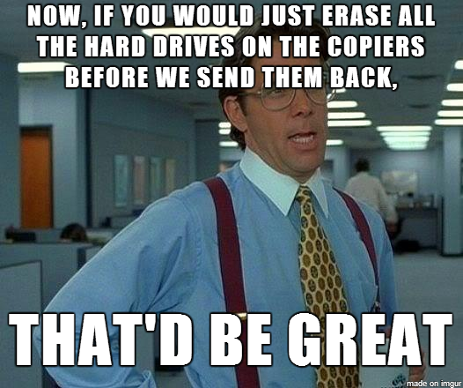
Paper Copies
Keep paper copies as secure as electronic data:
Consider whether you really need a paper copy
Remember that copier/printer/scanners store images of all documents on hard drives
Be mindful of where you are printing
Don’t leave paper copies sitting on printers
Store paper copies in a secure area
Notes:
Notes
Hard drive data destruction is usually addressed in lease terms, but cases where data is not destroyed have occurred.
Some organizations require that the hard drive be removed before the copier is returned at the end of a lease.

Slide 21
Data Destruction
Destroy documents and files when no longer needed:
Minimize the amount of data retained
Remove data in a way that renders it unreadable (paper) or irretrievable (digital)
Require third parties receiving PII under the FERPA School Official Exception to destroy it when the relationship is terminated or when no longer needed (whichever comes first)
See link below for access to “Best Practices for Data Destruction”
See Best Practices for Data Destruction - PTAC
Notes:
Notes
Minimizing the amount of data retained is key!
Methods of destruction may depend on the sensitivity of the data.
See Best Practices for Data Destruction (2014-05-06).pdf on website

Slide 22
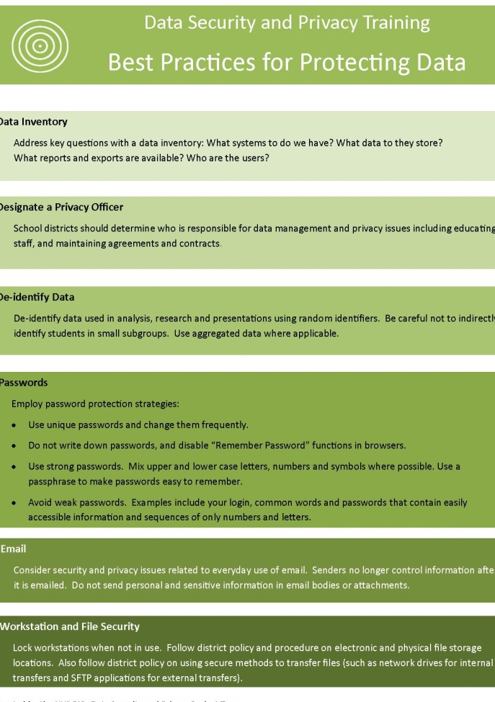
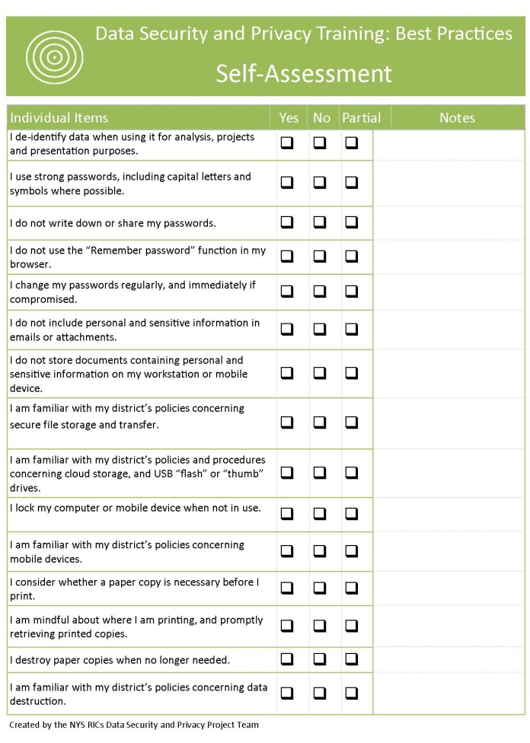
Best Practices for Protecting Data
Key Ideas
Self-Assessment
Notes:
Notes
Summarize the section and refer to the Key Ideas handout.
Use Self Assessments can be utilized in sessions, or as takeaways at the discretion of the presenter.

